Slide 1

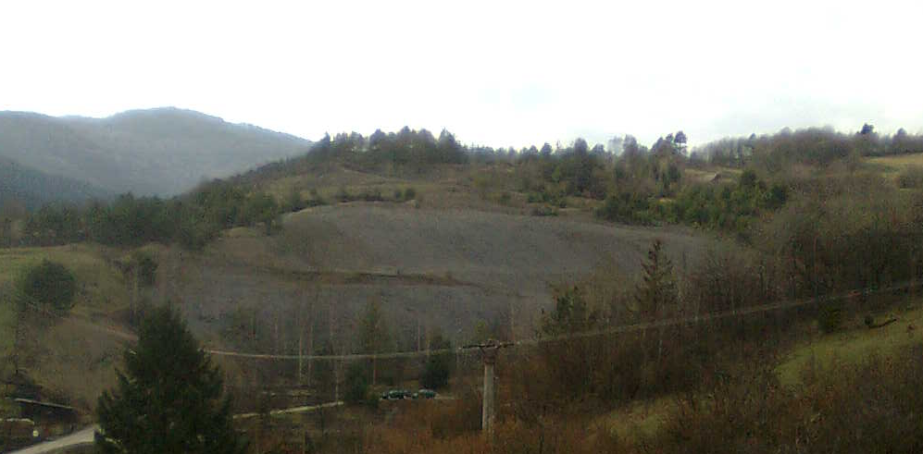
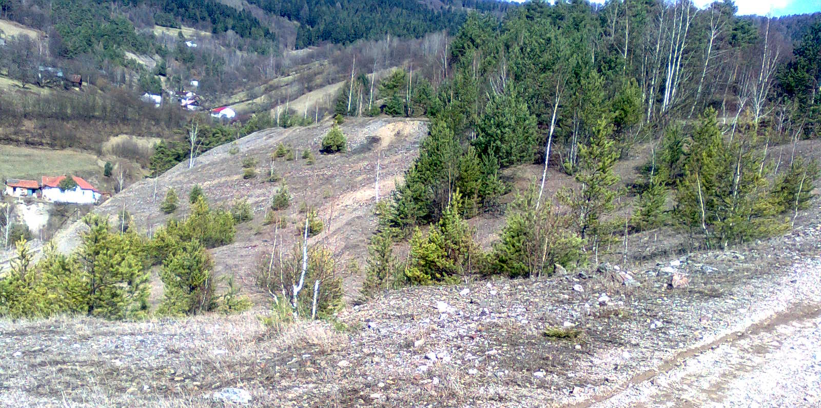
Abstract
Mining heaps are piles of spoil which as remnants after uneffective medieval mining of ores pose permanent environmental threat. This work analyses a secondary complex of mining heap with a total area of around 5 500 square meters which is located at Slovenské Cechy-Gaple in Košice region in the east of Slovakia. The work describes geo-ecological characteristics, occurrence of different types of organisms which occupy the spoil heap despite the given inhospitable conditions, as well as it watches the environmental impact of the heap on human. Moreover, it presents pH properties of heap´s soil, description of occurence and occupation of vegetation (worked out phytocenological records), fungi and animals. It is also about presence of toxic metals in a lichen Cladonia arbuscula subsp. mitis which is a result of their high concentration in the soil of the heap and also about their presence in water from a well that is located on the spoil heap as well as in the one located under the heap which is used a source of water for local population. Our conclusions state that the most spread species occupying the heap are Agrostis capillaris and lichens Cladonia arbuscula subsp. mitis a Stereocaulon dactylophyllum. Vegetation covers around 40% of the total surface of the heap. In spite of the fact that the occurance of lichens Stereocaulon is still rich in the numbers, we may include them in the list of endangered and critically endangered species. The soil is characterized by acicid pH of 5.1. Our conclusions fully corelate with those of Banásová (2006), who examined mining heap located in Smolnícka Huta. In terms of occurance of animals, we recorded mainly invertebrates to live on the heap. In the most frequent lichen Cladonia arbuscula subsp. mitis there were primarily present elements like aluminium, iron, antimony and copper. By comparing metals present in examined lichen and their content in the soil from the heap which was examined by Banásová (2003), we found out that the lichen accumulated large amounts of the metals (except aluminium) that are mainly present in the soil. In the samples of water taken from the both wells mentioned above, there were such amounts of metals that are not toxic to human and satisfy normal values set by Government Regulation of SR 496/2010. In a contrary view on the spoil heap as a potential source of dangerous metals, as well as a place suitable for a broad spectrum of endangered and valuable lichens we might say they require and should have at least some of our attention – as well as educational eco-geological pathway which will belong and serve to everyone.
Goals
to describe ecological conditions, geological composition of the heap and content of toxic metals in the soil from the heap in Gelnica more precisely in Slovenské Cechy-Gaple,
to determine acid-base properties of the soil,
to describe vegetation occupying central and peripheral part of the heap, determine dominant species of the heap and conduct phytocenological records,
to determine fungi species which habitate the heap as well as animal species which live on the heap either temporarily or permanently,
to find out the in Gelnica located in Slovenské Cechy,
to compare the content of the metals in the heap with their content in the lichen,
to conduct chemical analysis of the samples from both wells wihch are on and under the heap in Gelnica on the Banícka street,
to compare the presence and content of the elements in water samples from both researched places with the content of metals in the heap and also with standards for drinkable water.
Methods
We conducted our terrain research with respect to the Zurrich-Montpeliere methods and we used combined Braun-Blanquet coverage and frequency scale when creating the phytocenological (Braun-Blanquet, 1964).
To determine pH properties of the water and soil we used a special pH-meter. When determining vegetation species we worked with publications Trávy (Graun a kol., 1998), Zoznam nižších a vyšších rastlín Slovenska (Marhold a Hindák, 1998), Veľká kniha rastlín hornín, minerálov a skamenelín (Krejča a kol., 1997) and a pack of different websites and other publications which are listed under the used literature.
When determinig lichen species and content of toxic metals in a lichen Cladonia arbuscula subsp. mitis we cooperated prof. doc. RNDr. Martin Bačkor, PhD. from Katedra botaniky Prírodovedeckej fakulty UPJŠ in Košice. To verify the content of toxic metals we used a method of Flame Atomic Absorption Spectroscopy (FAAS).
When determing species of fungi we discussed it through email with Dr. Ivona Kautmanová from Slovak National Museum Analysis of water from the wells either on the heap and from the one under the heap took place on 23. of January by FAAS in cooperation with Accredited chemical laboratory in Spišská Nová Ves.
Introduction
Gelnica is an old mining town located in Košice region in the east of Slovakia. History of the town inextricably intervowen with mining, primarily with mining of copper and iron ores, but also of silver, mercury, lead and gold in locations like Turzov and Zenderling.
Pic. 1 View on the spoil heap from the side of Gelnica
Pic. 2 View on the spoil heap from locality Slovenské Cechy-Gaple

